Slide 1
Handshake: Open Source Social Networking Platform for the Enterprise
Donna L. Cuomo, PhD dcuomo@mitre.org Chief Information Architect
Laurie Damianos, Lead Engineer
The MITRE Corporation
May 2010

Slide 2
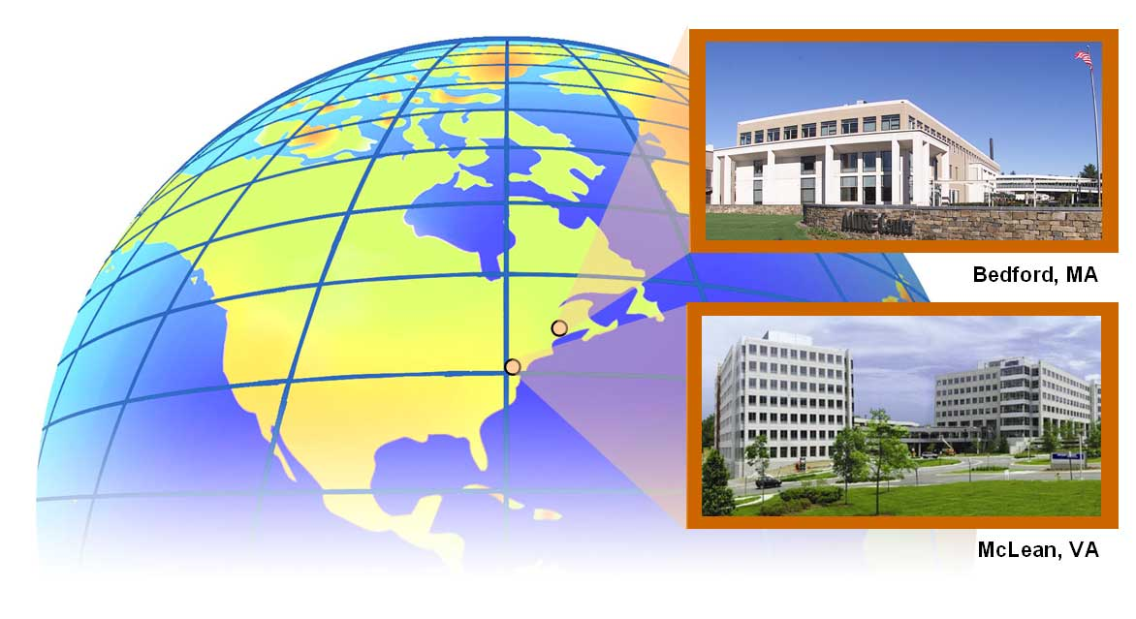
The MITRE Corporation
MITRE is a private, independent, not-for-profit organization, chartered to work in the public interest
Founded in 1958 to provide engineering and technical services to the U.S. Air Force
Currently manages 4 Federally Funded Research and Development Centers
Department of Defense
Federal Aviation Administration
Internal Revenue Service/Department of Veterans Affairs
Department of Homeland Security
Supports a broad and diverse set of sponsors within the U.S. government, as well as internationally
Bedford, Mass.
McLean, Va.
7,000 employees worldwide

Slide 4
Business Goals for Social Networking
Capture relationships of MITRE staff with partners, sponsors, industry, and academia
Leverage these relationships
Improve cross-organizational collaboration and networking
Bring broader segments of the community to bear on important sponsor problems
Vetting position papers/benchmarking with broad audiences
Enable new business models and federal processes
Deliver information to sponsors and partners
Support internal social networking
People tracking
Retirees, alumni, students/coops, consultants
Improve situational awareness around relationships, activities and groups

Slide 5
Solution Criteria
Deploy a social networking research platform
Fully customizable, extensible, measurable, integrate-able
Investigate the business value of cross organizational collaboration
What will make the capability successful?
Single platform for internal and partner networking
Fine-grained access control model available
Easy to use/walk up and use
No licensing costs for unlimited number of partner participants
Meet MITRE’s InfoSec and OpSec requirements
Most commercial internet systems do not
Secure and easy invitation model
Minimize sharing errors
Initial low cost solution

Slide 6
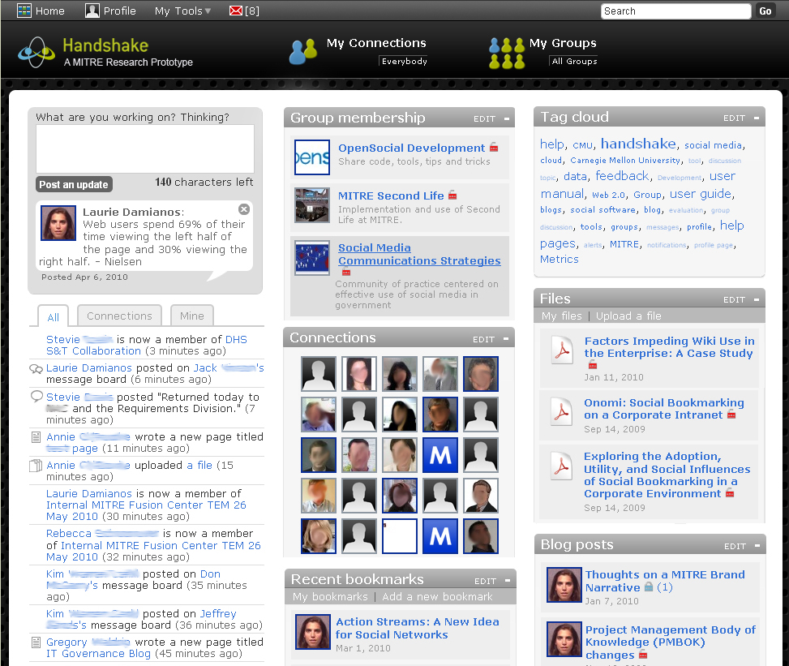
Extending MITRE’s Reach with Handshake
Social Networking Research Platform, powered by Elgg

Slide 7
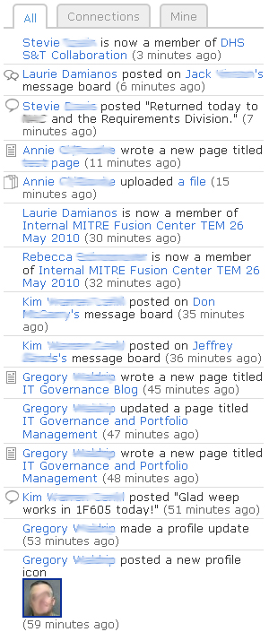
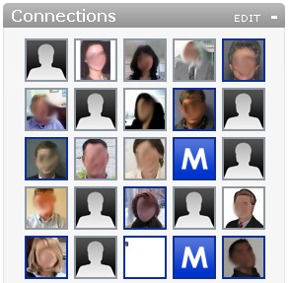
Home page provides access to… connections
…peripheral awareness of activity

Slide 8
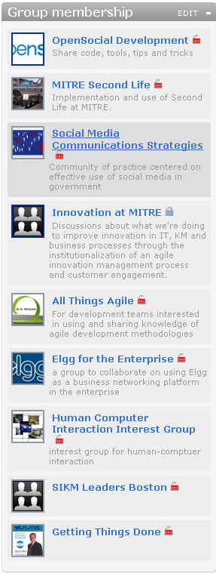
Home page provides access to…
…groups & communities

Slide 9
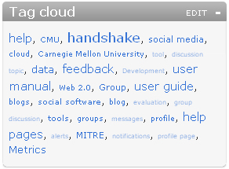
Home page provides access to…
…tagged content

Slide 10
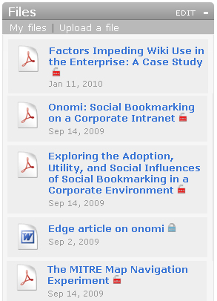
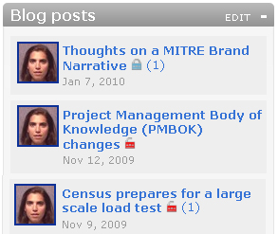
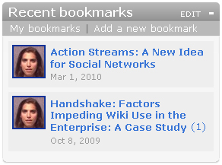
Home page provides access to…
…files, blogs, wiki pages, bookmarks, photos

Slide 11
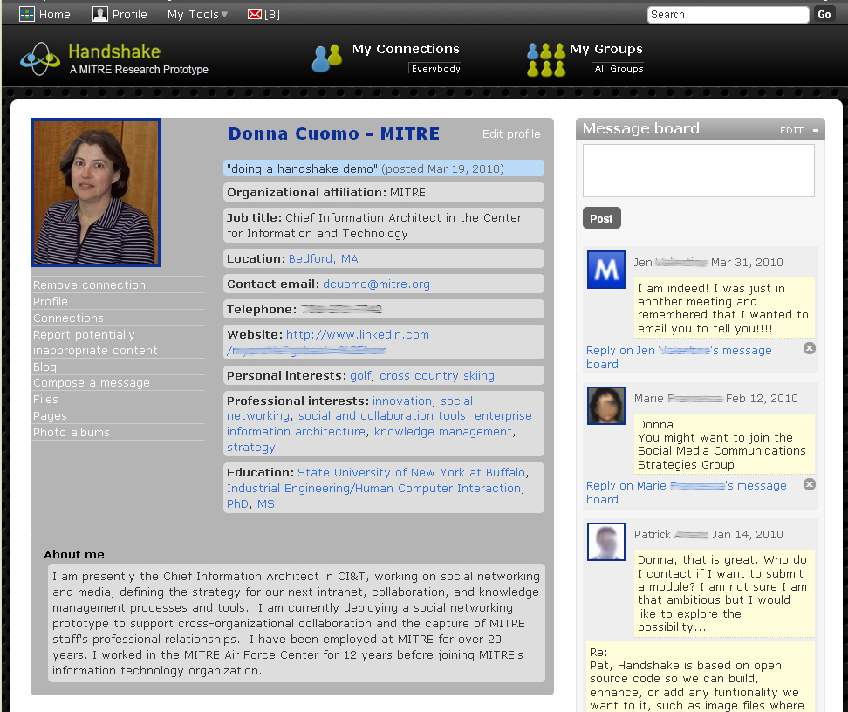
Profile page lets you share with others
Each profile field is access controlled
You choose what you share with whom

Slide 12
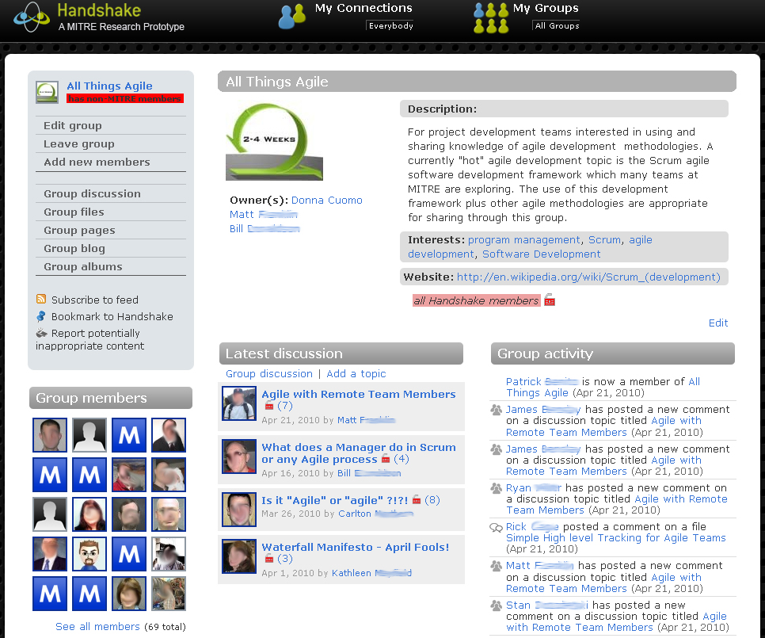
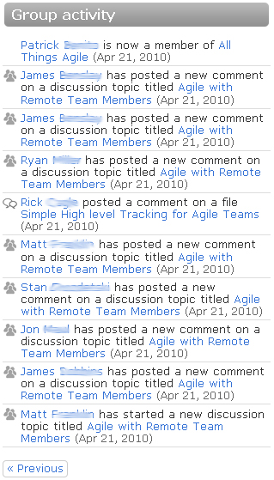
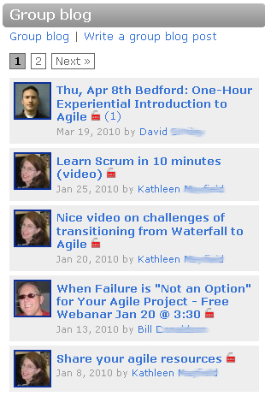
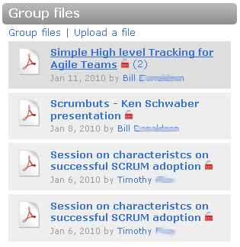
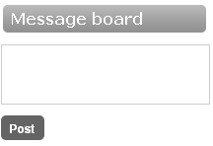
Groups provide a forum for collaboration

Slide 13
Quickly catch up with what’s been going on

Slide 14
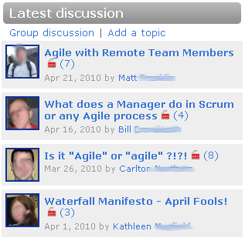
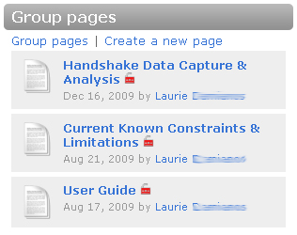
Engage in discussions, share resources, collaborate on wiki pages, post to blogs…

Slide 15
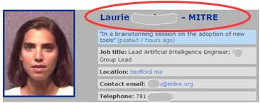
MITRE Customizations: Permissions & Trust
MITRE Identity model with single sign on
Authenticated email-based invitation model for inviting participants
“Box Model” for group permissions
Restricts contents to group permission level ceiling
Ensures that information is not inadvertently exposed
Visualized permissions & access
Every group
Each piece of content
Customized access levels

Slide 16
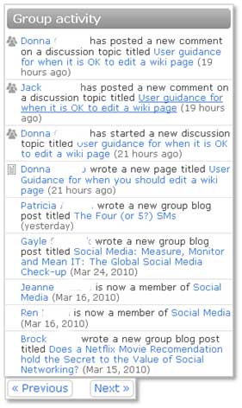
MITRE Customizations: Awareness
Released to open source community
Created group activity river
Scrollable access to activity history
Enhanced email notifications to activity
Clearer subject headings
Cleaner formatting
Hyperlinks to content, sender’s profile
Daily email digests
Full email integration in progress

Slide 17
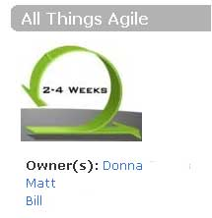
MITRE Customizations: Groups
Ability to restore accidentally deleted groups
Ability to “remove” group members
New group widgets
Group activity widget
Group Information widget – HTML form for lists, hyperlinks, images
Multiple group owners

Slide 18
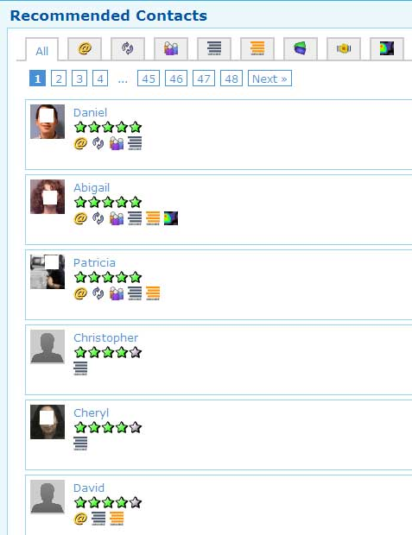
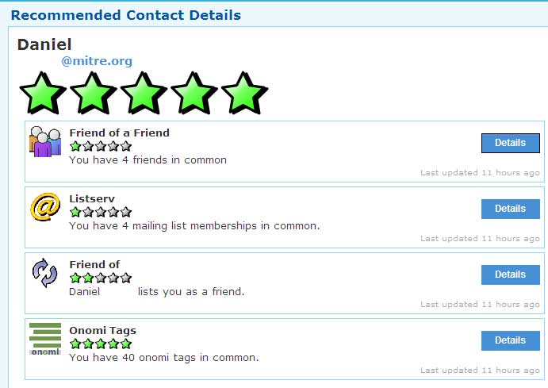
MITRE Customizations: End User Experience
Improved search
Streamlined navigation
Activity logging & data visualization for end users
Affiliated organizations model
Connections recommender – based on digital footprint
Released to open source community
Abigail Gertner & Justin Richer, MITRE

Slide 19
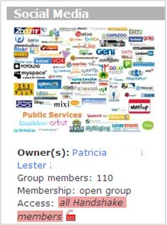
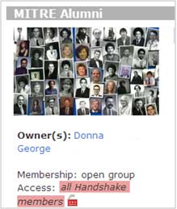
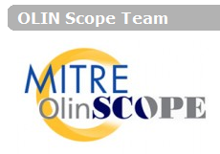
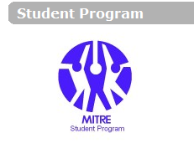
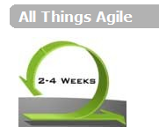
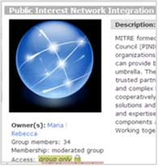
Handshake – Extending MITRE’s Reach
Early Responder Forum Handshake Group
- 100+ leaders from 45 States and 2 Territories
IBM, DISA, APL, P3CG STRATCOM, Aerospace, Gilbane, TraceLink, DNI
MITRE Retirees
People tracking
Cross-organizational teams/consortia
Communities of interest
Govt/acquisition processes
Internal teams and departments
Social networking research
Aerospace, JHU/APL Lincoln Lab Sandia, CAN SEI
High-level DoD medical simulation decision makers

Slide 20
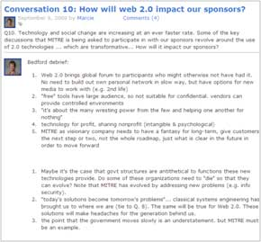
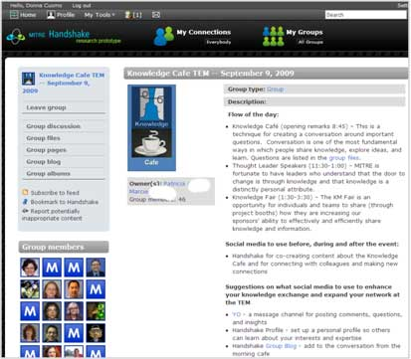
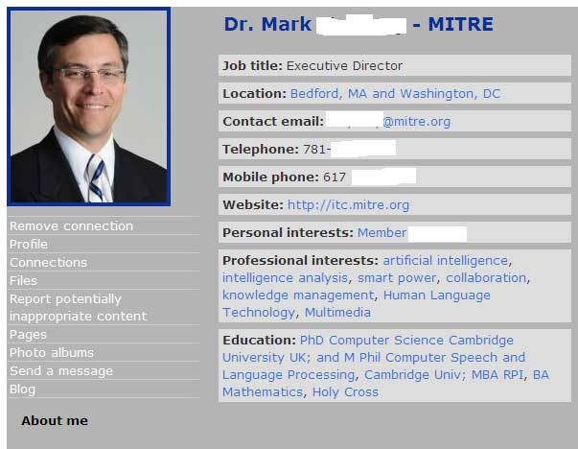
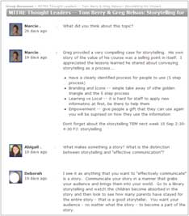
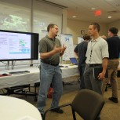
Distributed Knowledge Café using Social Tools
Morning speakers broadcast via VTC
Speakers had Handshake profiles
Participants in Bedford, MA and Wash. DC
Face-to-face demonstrations in afternoon on both sides
Blogging and discussions throughout the day

Slide 21
User Adoption & Growth
170 groups & communities

Slide 22
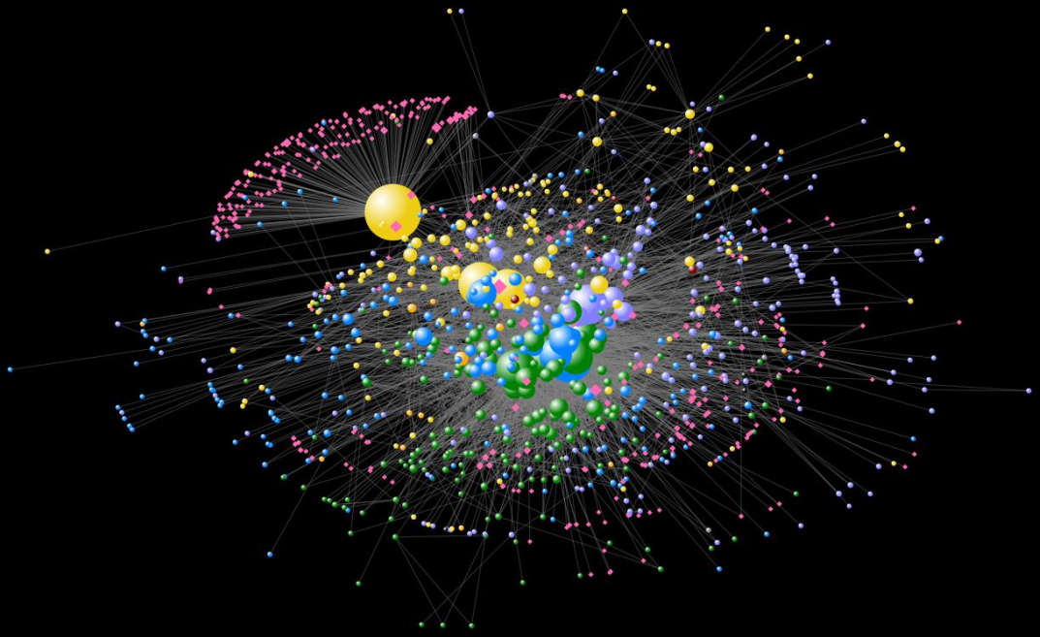
MITRE-Partner Social Graph
Each node represents a Handshake user
Size of node is proportional to number of connections
External users are hot pink
CCG = orangey/yellow
Corporate = green
C2C = lavender
CIIS = blue
CAASD = orange
DOD C3I = maroon
Contractor = gray

Slide 23
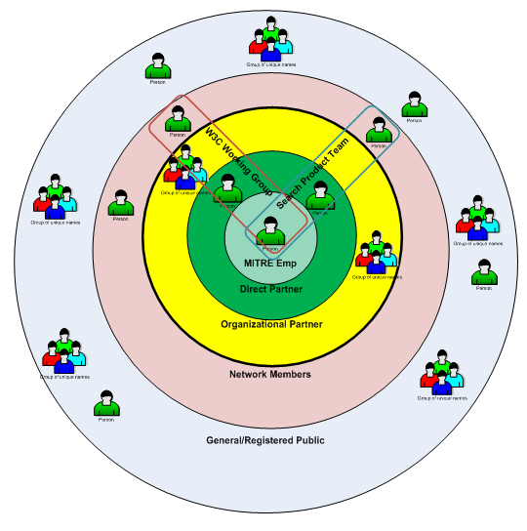
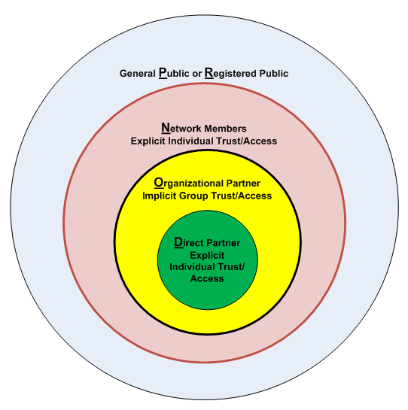
Identity, Privilege and Access Model - in Progress
Organizational partners are users from established partner organizations.
Organizational partners can “self join” – invitation from MITRE employee not required.
Direct partner (explicitly granted to individuals) – can be co-group owners, invite others from their own organization.

Slide 24
Advantages of Open Source for Research
Price
No software purchase cost
No initial investment solution
No licensing costs based on # of users
Met our InfoSec requirements
Internal hosting on our own servers
Extensible & modifiable
We change what we want (e.g., usability, invitation model)
We set our own priorities (e.g., enterprise enhancements, permissions)
We build what we want (e.g., Affiliated Partners)
We can integrate (e.g., single sign on, email, contact recommender system)
We instrument for evaluation & research
Access to community
We leverage others’ contributions & plug-ins
We share back changes for use by “friends” (e.g., Aerospace, JHU/APL, World Bank, etc)
But …
We wish more code modifications were shared back
We worry about the vitality of the open source dev community

Slide 25
Advantages of Using Elgg
Key features already built in
Plug-in model allows for extensibility without modifying core
Granular access control model supports a critical requirement
“Social networking” functionality is important to our model
New release 1.7.1 provides API access to social graph
Strong open source community
Good community traction
MITRE has developed relationship with core Elgg developers
Elgg developers are responsive to our needs & concerns
Our contributions to code base give us “street cred
But …
Not polished product
Not enterprise focused
Not security focused
Inconsistent user experience
Lacks full-text search
(Some of this is being addressed)
Little support, training, or documentation
Hard to get input into roadmap
(Curverider will provide some consultancy)
(Hosted service to be launched in May)

Slide 26
Our Next Steps
Enhancements
Upgrade to Elgg 1.7.1, provides APIs for My MII v2 integration.
Improve browsing/searching/filtering for users & groups
Development
Pulse of Handshake – what’s new, what’s happening, what’s big
Ability to customize groups
Extend permissions model
Assessing Business Value
Finalize evaluation plan
Complete instrumentation of Handshake for data collection
Track activities and analyze logs

Slide 27
Any questions?

Slide 28
*Adapted from Gartner, Drakos, 2009

Slide 29
User Feedback
I had to transition what I was doing with my sponsor and lost connection with all these people. Now I have a way to keep in contact with them, and it’s been great.
It’s a very lightweight way to share information with my project team and department. It’s frictionless and effective.
I have an excuse to “talk” to people I would otherwise not have the opportunity to.
Handshake provides the only way we can collaborate with our sponsor and our sponsors’ stakeholders – other than email and phone.
People come up to me and say, “Hey, I’ve seen you on Handshake.” Handshake has been useful for growing my cross-center network.

